Slide 1
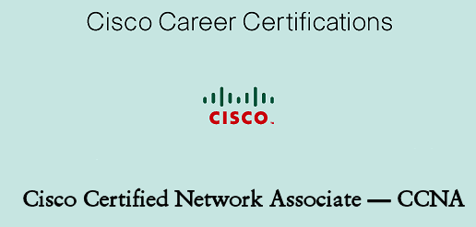

Network Infra Structure upgrade For Organization (LOCAL NETWORK CONNECTIVITY)
Presented By :-
ABHISHEK MADHU | 14041133
ANKIT KIRAULA | 14041116

Slide 2
WHAT IS NETWORKING ?
Networking is a process of connecting two or more computers for sharing. Through the networking, computers share information such as email, file, documents and resources such as printer, internet and disk storage.

Slide 3
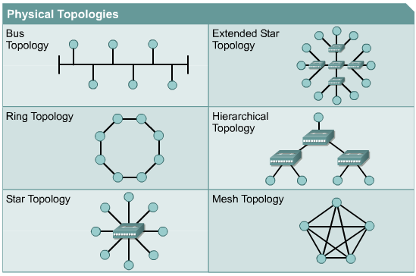
Network Topology

Slide 4
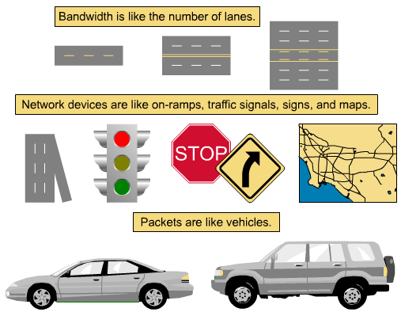
Bandwidth Highway Analogy

Slide 5
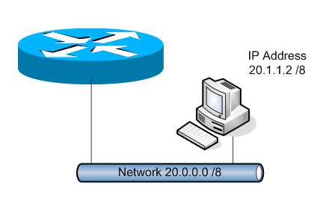
Routing Process
Routing is the process of selecting paths in a network along which to send network traffic. Routing is performed for many kinds of networks, including the telephone network (circuit switching), electronic data networks (such as the Internet), and transportation networks

Slide 6
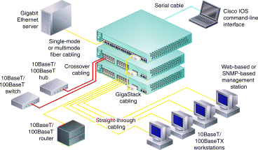
Switching Process
A network switch (also called switching hub, bridging hub, officially MAC bridge) is a computer networking device that connects devices together on a computer network by using packet switching to receive, process, and forward data to the destination device

Slide 7
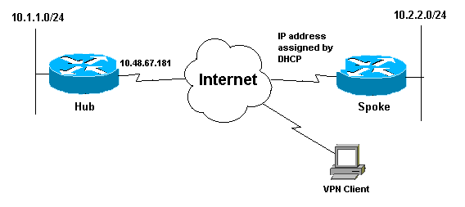
LAN Technology(Local Network)
A local area network is a computer network that interconnects computers within a limited area such as a residence, school, laboratory, university campus or office building

Slide 8
Protocol Used
Router Protocol:-
OSPF(open shortest path First)
Telnet
SSh
Security
Switch Protocol:-
VLAN(Virtual Local Area Network)
Telnet
SSh
Security
Telephonic

Slide 9
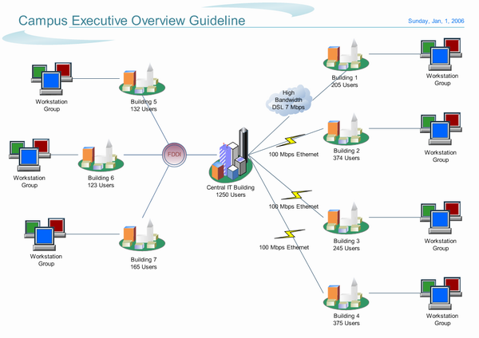

Slide 10
Networking And Monitoring Tools
Teraterm
Putty
Wireshak
Subnet and IP Calculator
Console Cable
Speedtest and much more
CCP(Cisco Configuration Professional)
NetFlow
Top Talkers
NBAR
QOS

Slide 11
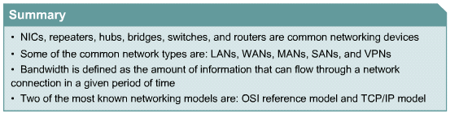
Summary

Slide 12

References
Cisco Systems, Inc., (2003, March 14). CCNA:
network media types. Retrieved from ciscopress.com
Shelly, Gary, et al. "Discovering Computers" 2003 Edition
Odom, Wendall, "CCNA Certification Guide"
www.cisco.com
www.supportcisco.com
www.youtube.com

Slide 13
REST OF THING AVAILABLE IN DOCUMENTATION ☺ ☺
THANKING YOU ☺

